Slide 1
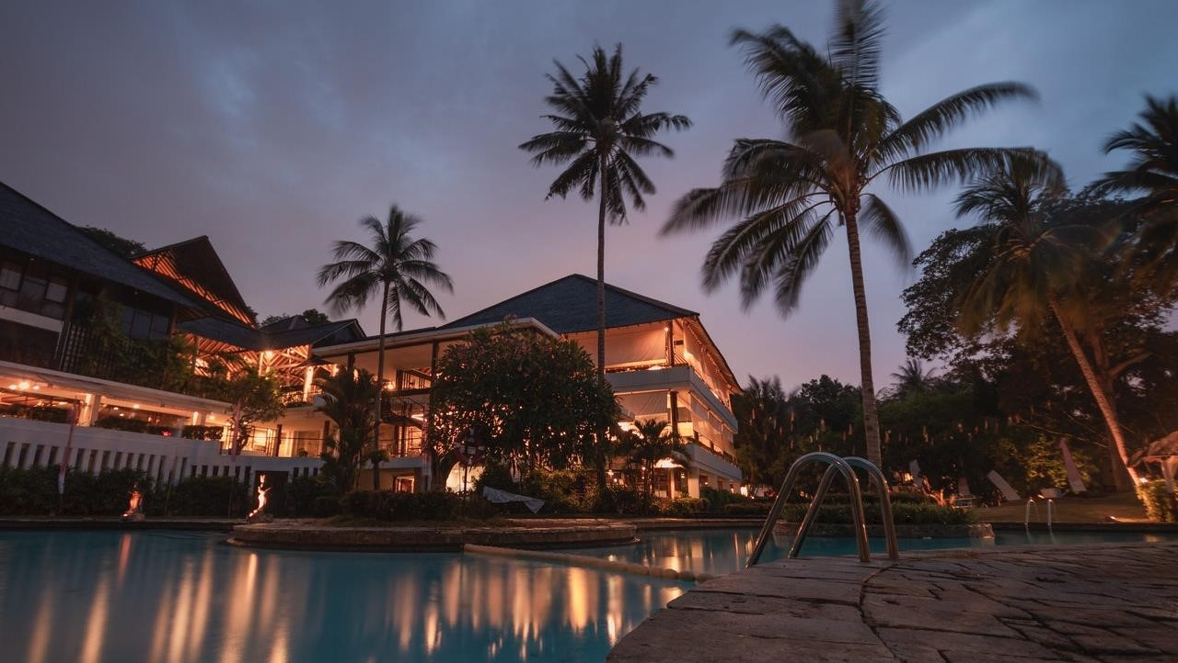
ATLIQ GRANDS HOSPITALITY - ANALYSIS
BY: SHILPA NAGPAL

Slide 2
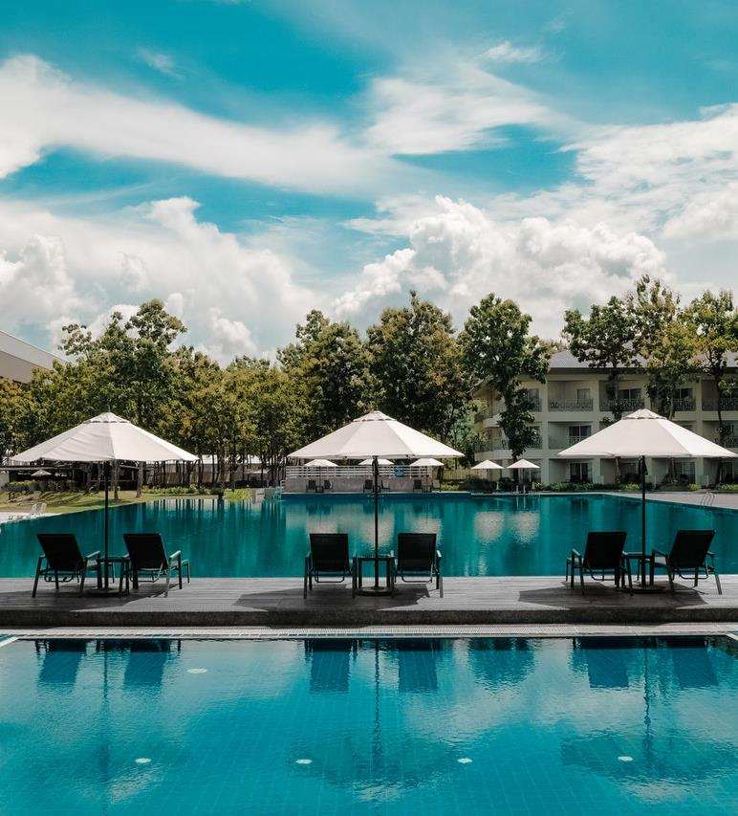
Problem Statement
Atliq Grands owns multiple five-star hotels across India. They have been in the hospitality industry for the past 20 years. Due to strategic moves from other competitors and ineffective decision-making in management, Atliq Grands are losing its market share and revenue in the luxury/business hotels category. As a strategic move, the managing director of Atliq Grands wanted to incorporate “Business and Data Intelligence” in order to regain their market share and revenue.
However, they do not have an in-house data analytics team to provide them with these insights. Their revenue management team had decided to hire a 3rd party service provider to provide them with insights from their historical data.
PROJECT TITLE | AtliQ Hospitality Analysis
TECHNOLOGY | Data Science
DOMAIN | Travel and Tourism
PROJECT DIFFICULTY LEVEL | Advance
PROGRAMMING LANGUAGE USED | Python
TOOLS USED | Jupyter Notebook, MS-Excel, Tableau

Slide 3
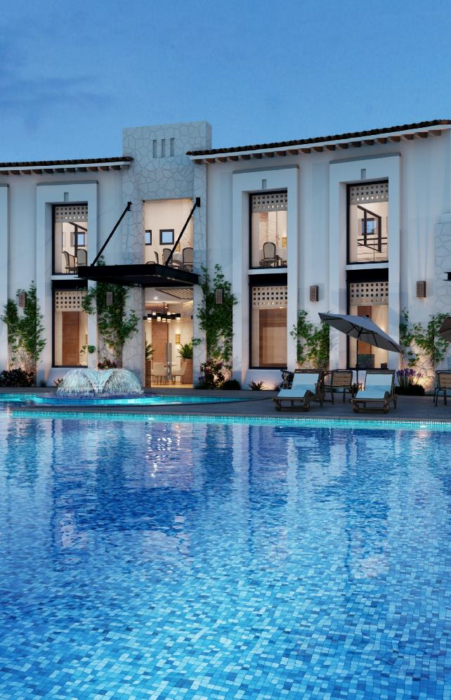
ARCHITECTURE
Raw data Collection
Importing Libraries in Jupiter Notebook
Load dataset
Missing Values imputations
Handling outliers
Data Cleaning
Exploratory Data Analysis (EDA)
Modelling
Tableau Public Desktop
Insights
Reporting

Slide 4
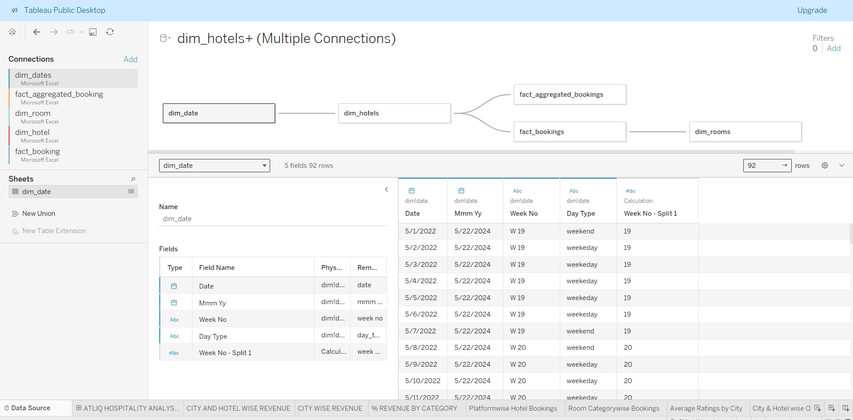
DATA SOURCE

Slide 5
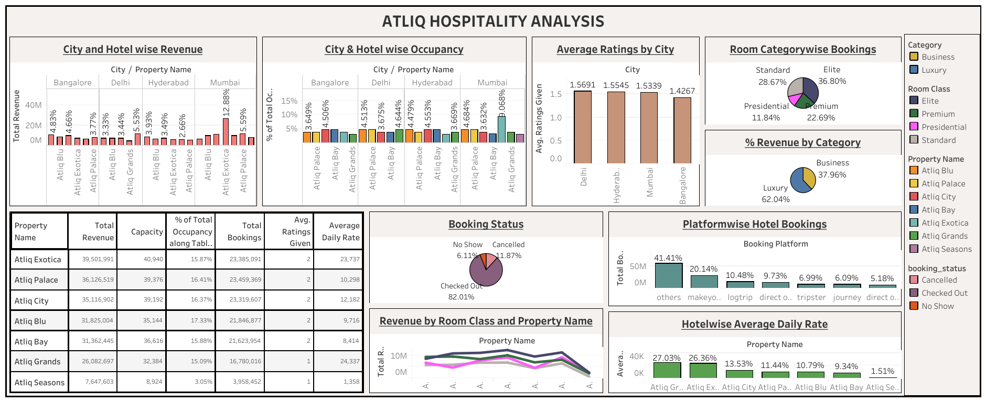
DASHBOARD

Slide 6
INSIGHTS
Hotel wise Revenue: Atliq Exotica Hotel and Atliq Seasons Hotel contributes highest and lowest proportion in revenue generation of Atliq. We need to take strategic moves to improve Atliq Seasons revenue generation
City and Hotel Wise Revenue Generation: In Mumbai Atliq Exotica generates highest amount of revenue.All other hotels in Bangalore,Hyderabad generating approximately same amount of revenue. But in Delhi Atliq Grands generating less revenue as compared to others.
City wise Revenue: For Atliq Mumbai and Bangalore City generating around 63%of total Revenue. Delhi is contributing only 17.23% of total Revenue.
Hotel wise Occupancy Analysis: From the analysis we can see Atliq Blu,Atliq Palace, Atliq City occupancy percentage is more than 60%. But for Atliq Seasons occupancy is only 45%. That is one of the reasons it is generating less revenue.
Daytype Wise Occupancy: In Atliq occupancy during weekends is 73.58% and during weekdays 51.34% . People books more during weekends. This analysis can help to improve pricing plans during weekends.
Booking Platform wise booking Analysis: Most of the hotel booking were done by the platform which is not mentioned here. And using offline method very less amount people used to book hotels.
Hotel wise ADR(Average Daily Revenue): In city Bangalore Average Daily Revenue is less as compared to other city hotels.

Slide 7
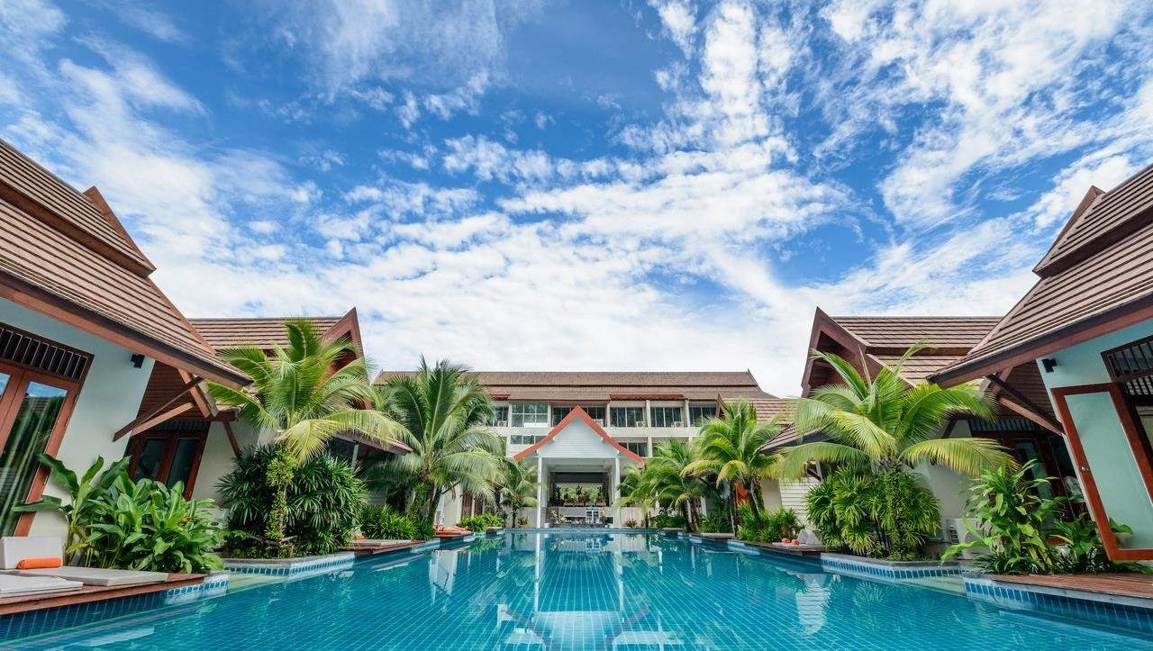
THANK YOU!!

